Slide 1
Explainable AI
Yogesh Kulkarni

Slide 2
A Sample Digitization Project …
Number of Contracts to be Digitized : 60K
Number of Clauses to be discovered : 32 (“Term”, “Warranty”, …)
Number of Attributes to be discovered: 12 (“Effective Date”, “Contract Value”,…)
Time : 3 months

Slide 3
Steps …
Build AI Engine using annotated samples to extract attributes
Show results of training to the Customer and get approval
Start extractions (production) for all the contracts, in batches …

Slide 4
Halfway through the production …
Notes:
What is customer ask?
Who is the user?

Slide 5
A sample dialog
Customer: The extractions are looking ok, but…
AIML team: But??
Customer: Why are you digitizing these ‘DELLA’ contracts?
AIML team: Meaning?
Customer: You should not digitize contracts having ‘DELLA Corporation’ in the footer.
AIML team: But you never told us. No mention of any such rules in SOW also..
Customer: We are just asking you to NOT process these, not adding to your work/scope!!
AIML team: But….
Customer: Shouldn’t be difficult, right? AI will find out…

Slide 6
(we keep hearing…)
AI will find out!!
Notes:
What is customer ask?
Who is the user?

Slide 7
(sometimes…)
AI should find out!!
Notes:
What is customer ask?
Who is the user?

Slide 8
(what if…)
AI can not find out!!
Notes:
What is customer ask?
Who is the user?

Slide 9
(and worse if …)
AI finds it and finds it wrongly!!
Notes:
What is customer ask?
Who is the user?

Slide 10
(bottom line… we need to understand that)
AI is not Magic!!
Notes:
What is customer ask?
Who is the user?

Slide 11
(But still, you need to explain me)
Why AI gave this result!!
Notes:
What is customer ask?
Who is the user?

Slide 12
(that’s)
Explainable AI
Notes:
What is customer ask?
Who is the user?

Slide 13
Overview
What is XAI ?

Slide 14
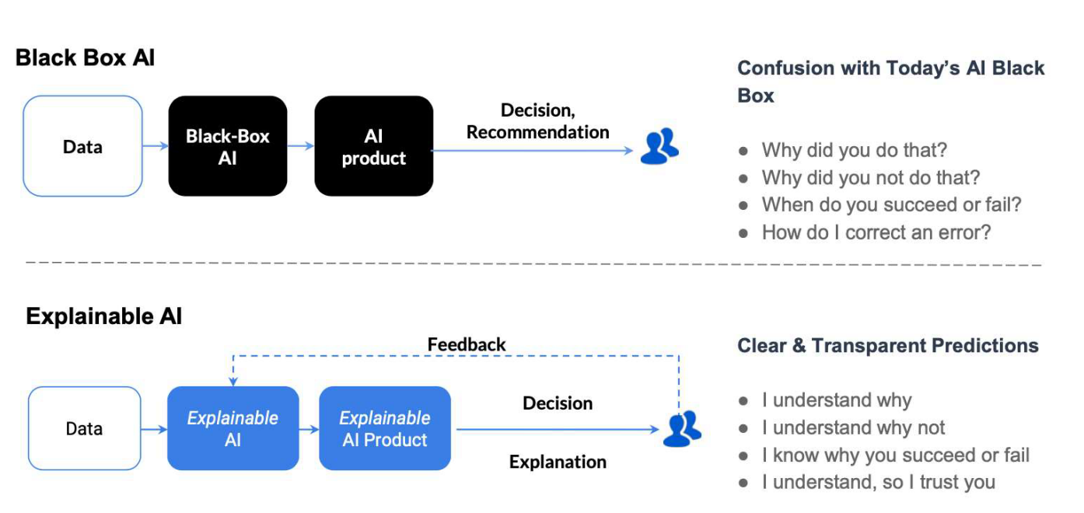
What is Explainable AI?
An explanation of how an automated system decided.
Interpretability of the predictions/results.
“Interpretability is the degree to which a human can understand the cause of a decision.” - Tim Miller
Gade, Geyik, Kenthapadi, Mithal, Taly. Explainable AI in Industry, WWW’2020

Slide 15
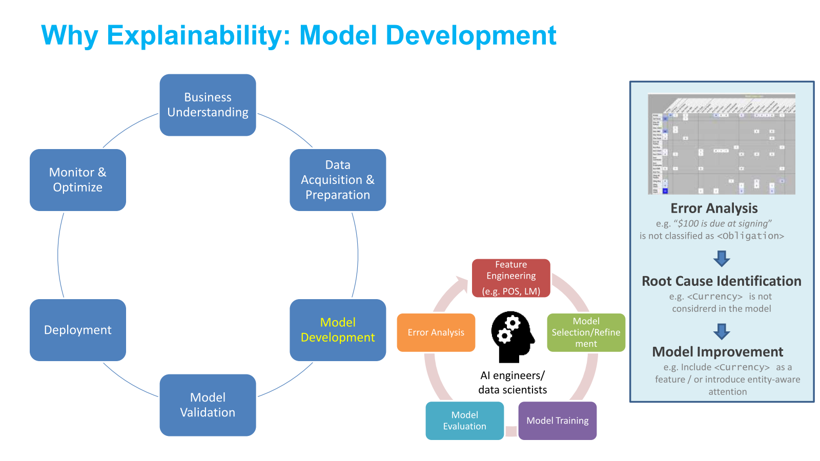
Explainability for Natural Language Processing - Tutorial@AACL-IJCNLP 2020

Slide 16
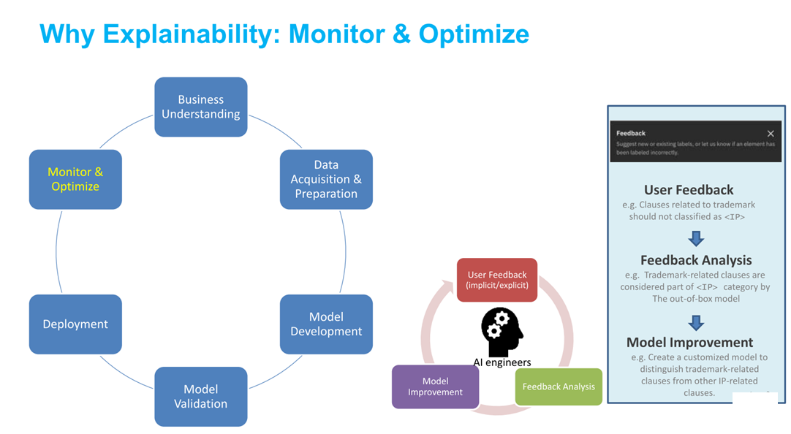
Explainability for Natural Language Processing - Tutorial@AACL-IJCNLP 2020

Slide 17
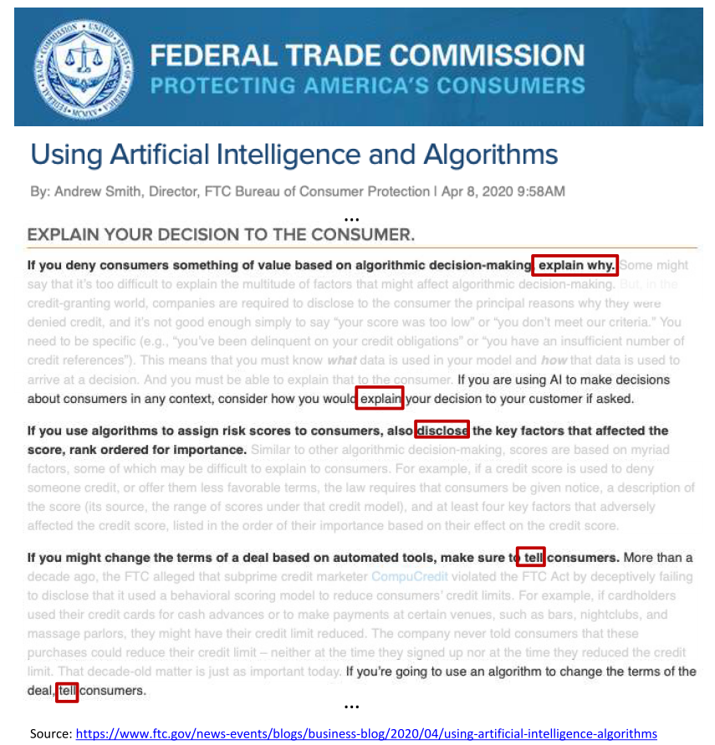
Regulatory Need
General Data Protection Regulation (GDPR): Article 22 empowers individuals with the right to demand
Massachusetts Bill H.2701: Establishes a commission on automated decision-making, transparency, fairness, and individual rights.
Illinois House Bill 3415: States predictive data analytics determining creditworthiness or hiring decisions may not include information that correlates with the applicant race or zip code.

Slide 18
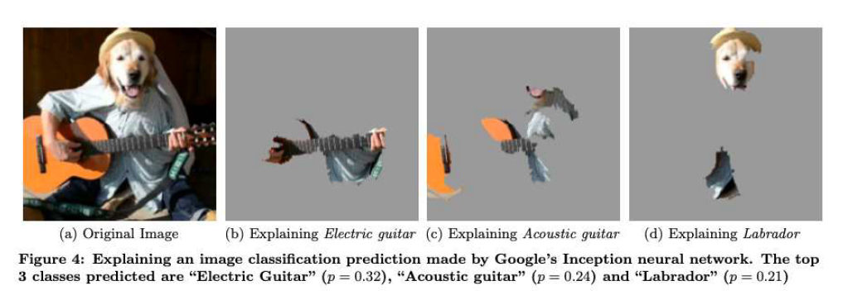
Example: Images
“Why Should I Trust You?” Explaining the Predictions of Any Classifier. KDD’2016

Slide 19
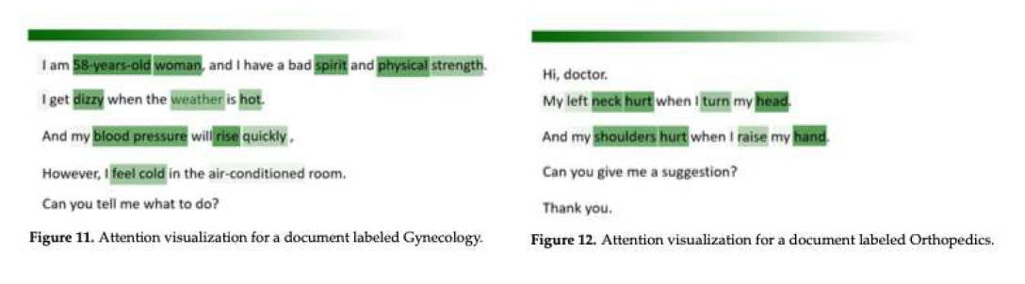
Example: Text
Outpatient Text Classification Using Attention-Based Bidirectional LSTM for Robot-Assisted Servicing in Hospital Information 2020

Slide 20
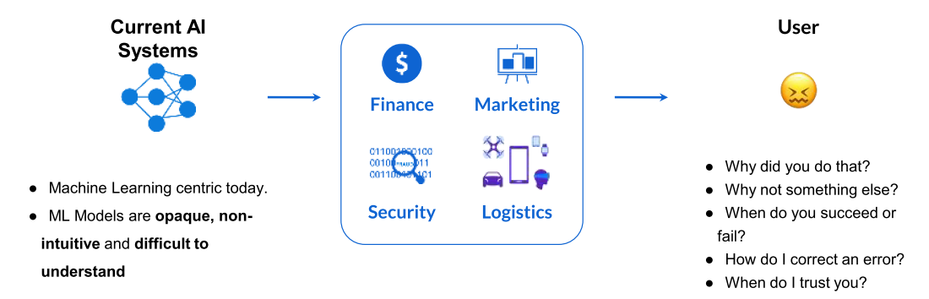
Need for Explainable AI
Explainable AI is essential for customers to understand and trust the decisions by AI.
(Explainable AI in Industry, KDD 2019 Tutorial,Sahin Cem Geyik, Krishnaram Kenthapadi & Varun Mithal )
Notes:
What is customer ask?
Who is the user?

Slide 21
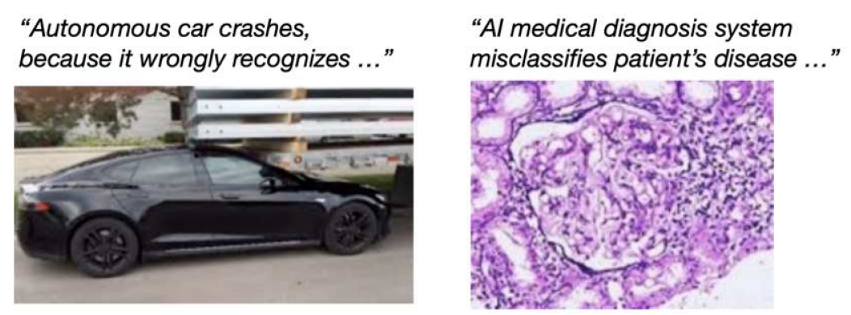
Wrong decisions: Costly and dangerous
(Credit: Samek, Binder, Tutorial on Interpretable ML, MICCAI’18)
Notes:
What is customer ask?
Who is the user?

Slide 22
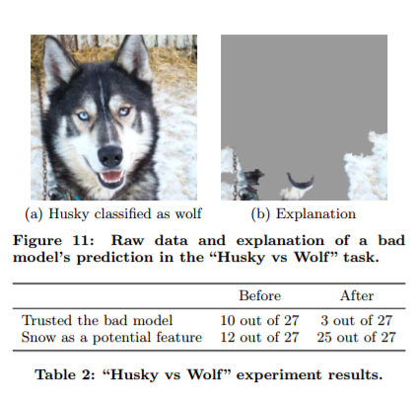
AI missed!!
Dog vs Wolf classifier
Instead of animal body features it started detecting based on ‘presence of snow’.
So Siberian Husky (a dog) got classified as Wolf.
Training data of wolves was with snow landscapes.
http://innovation.uci.edu/2017/08/husky-or-wolf-using-a-black-box-learning-model-to-avoid-adoption-errors/

Slide 23
-- “AI can make decisions better, but
Can it make better decisions”--
Notes:
What is customer ask?
Who is the user?

Slide 24
AI as Black Box
Why did the AI system do that?
Why didn’t the AI system do something else?
When did the AI system succeed?
When did the AI system fail?
When does the AI system give enough confidence in the decision that you can trust it?
How can the AI system correct an error?
Explainable AI (XAI) – A Perspective, Saurabh Kaushik

Slide 25
Explainable AI

Slide 26
Three Key Pillars of Explainable AI
Reasonable AI: The ability to understand the reasoning behind each individual prediction
Traceable AI: The ability to trace prediction process from algorithm to data.
Understandable AI: The ability to fully understand the AI decision-making is based
“Right to Explanation” – GDPR
Explainable AI (XAI) – A Perspective, Saurabh Kaushik

Slide 27
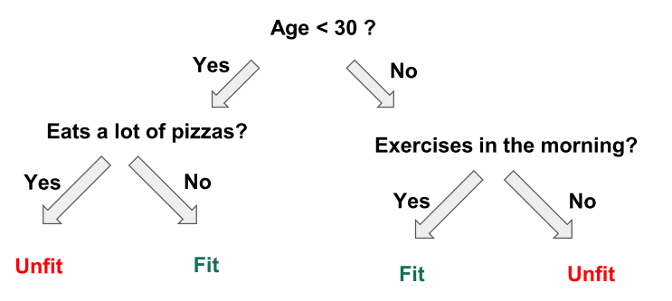
Achieving Explainable AI
Prediction explanations
Important features
Features weights
Decision tree plotting
Build an interpretable model using libraries like LIME, SHAP, etc.
Explainable AI in Industry, KDD 2019 Tutorial,Sahin Cem Geyik, Krishnaram Kenthapadi & Varun Mithal

Slide 28
“Interpretability is the degree to which a human can
understand the cause of a decision.”
(Miller, Tim. 2017. “Explanation in Artificial Intelligence: Insights from the Social Sciences.”)
Notes:
What is customer ask?
Who is the user?

Slide 29
So, What (exactly) is AI?

Slide 30
(typical understanding)
If Machines show intelligence, like Humans
that’s AI
Notes:
What is customer ask?
Who is the user?

Slide 31
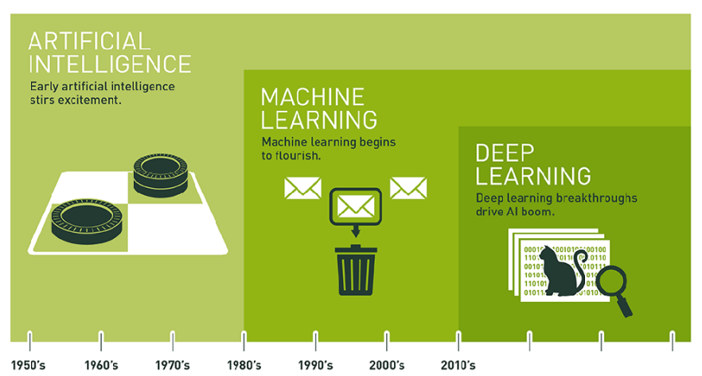

Slide 32
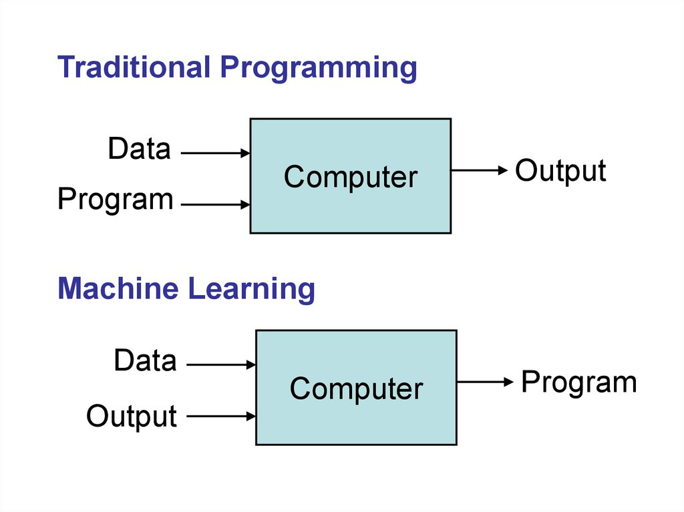

Slide 33
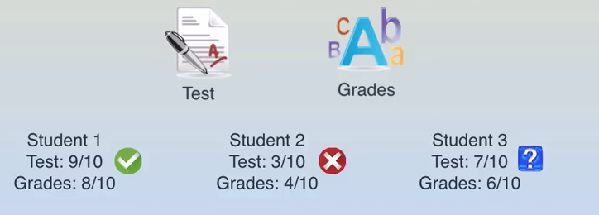

Slide 34
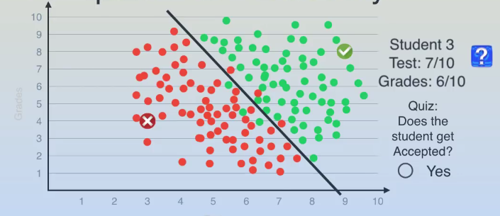

Slide 35
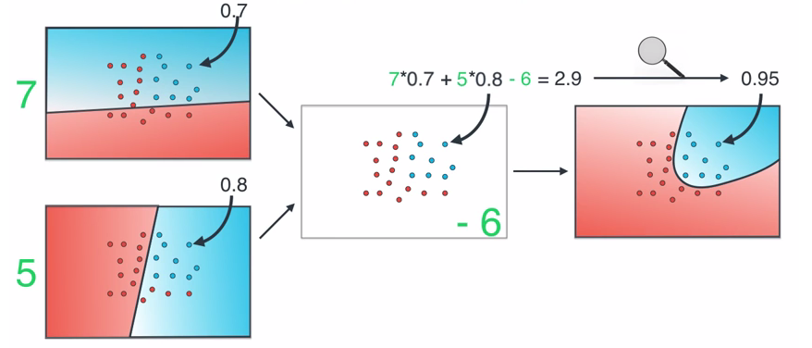

Slide 36
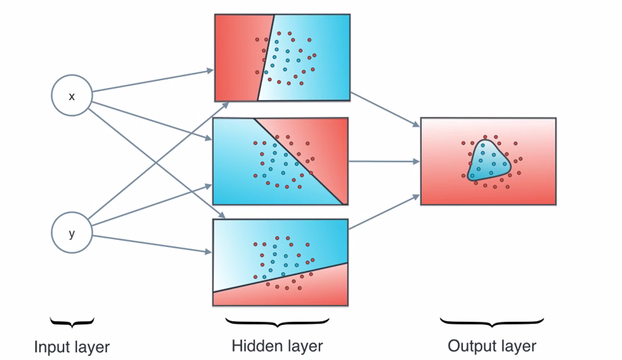

Slide 37
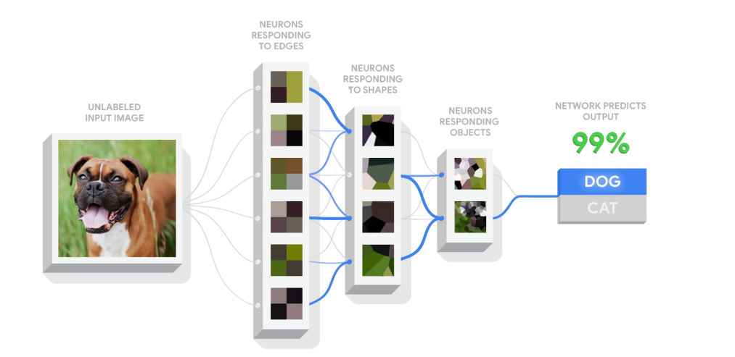

Slide 38
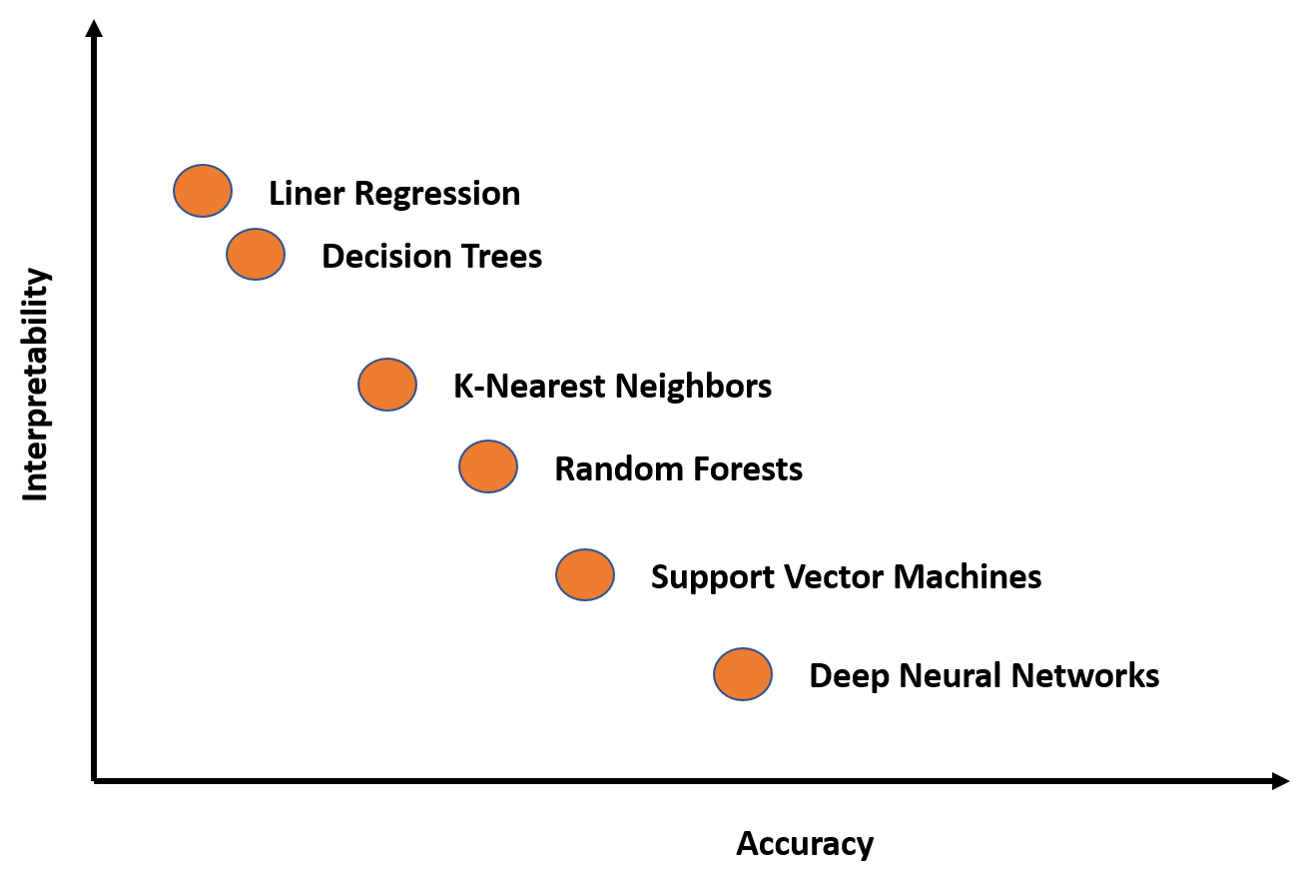
But…
(Application of artificial intelligence in gastroenterology, April 2019,World Journal of Gastroenterology 25(14):1666-1683)

Slide 39
Explain-ability of AI Algorithms
Regression – Multinomial Equation can be messy
Random Forrest – Multiple Tree and their Data Set and Voting
SVM – Kernel and Data Partition effect on Feature
K Mean – Nature of Centroid don’t describe cluster well.
NN – Hidden Nodes and their way of creating features
Explainable AI (XAI) – A Perspective, Saurabh Kaushik

Slide 40
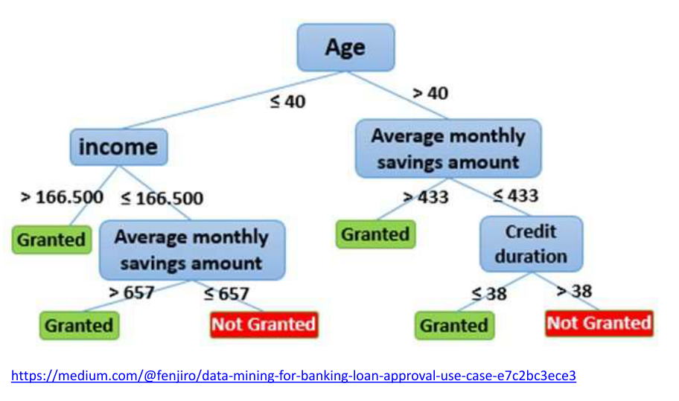
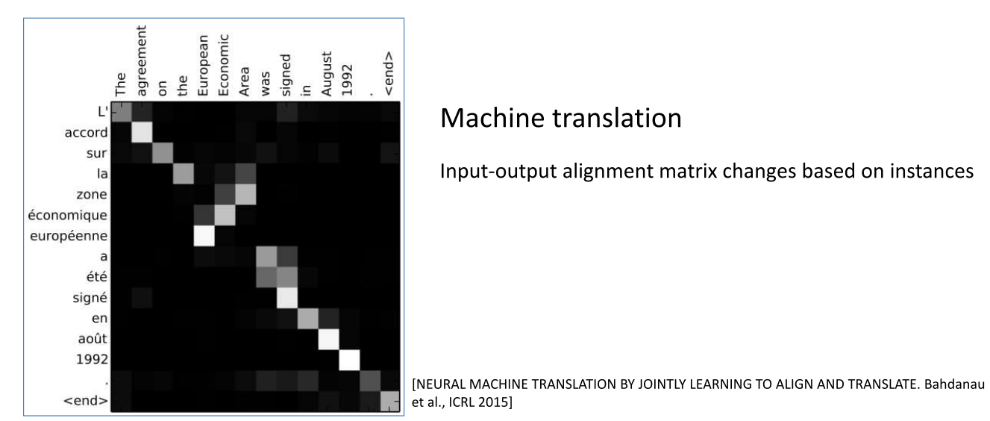
Terminologies
Local vs Global
Local explanation: individual instance
Global explanation: internal mechanism of a model
Self-explaining vs Post-hoc:
Self-explaining: directly interpretable
Post-hoc: a second step is needed to get explanation

Slide 41
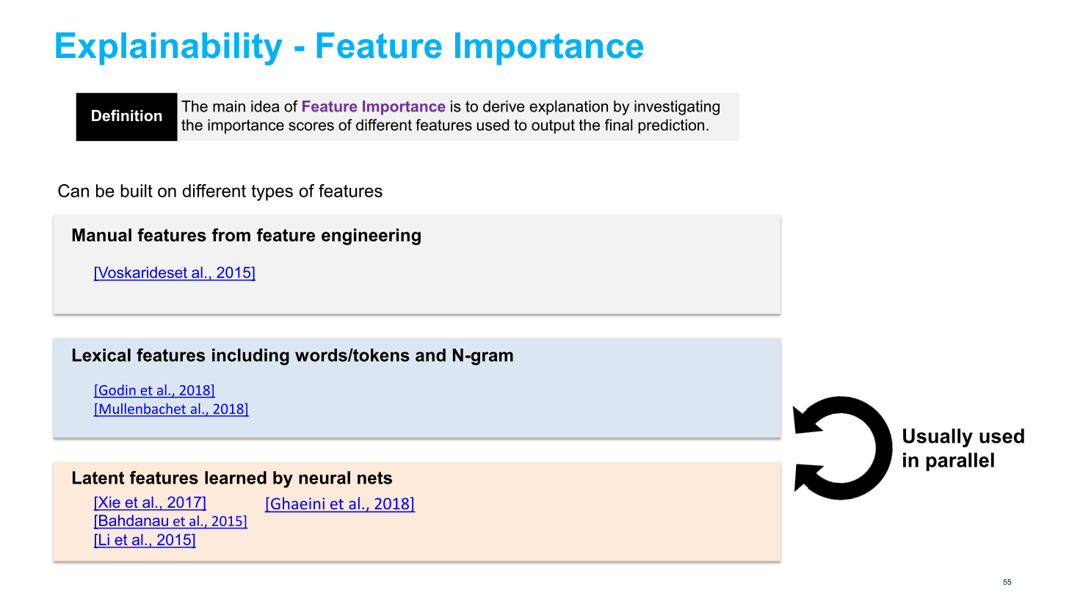

Slide 42
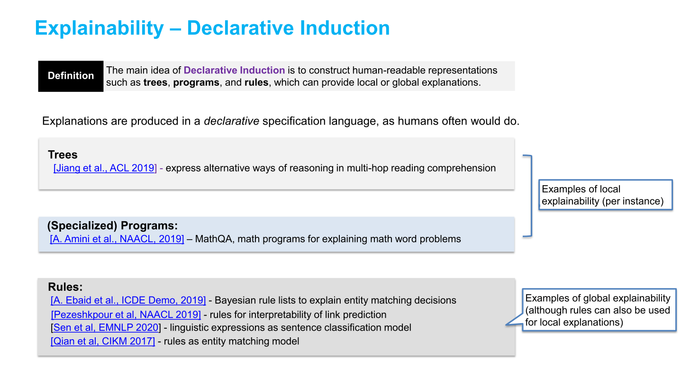

Slide 43
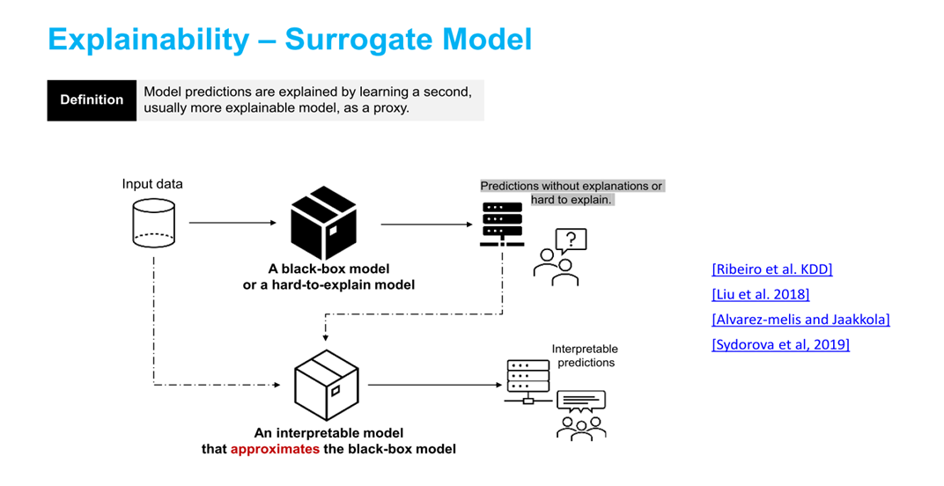
LIME: Local Interpretable Model-agnostic Explanations
Local & Post-hoc
High flexibility – free to choose any interpretable surrogate models

Slide 44
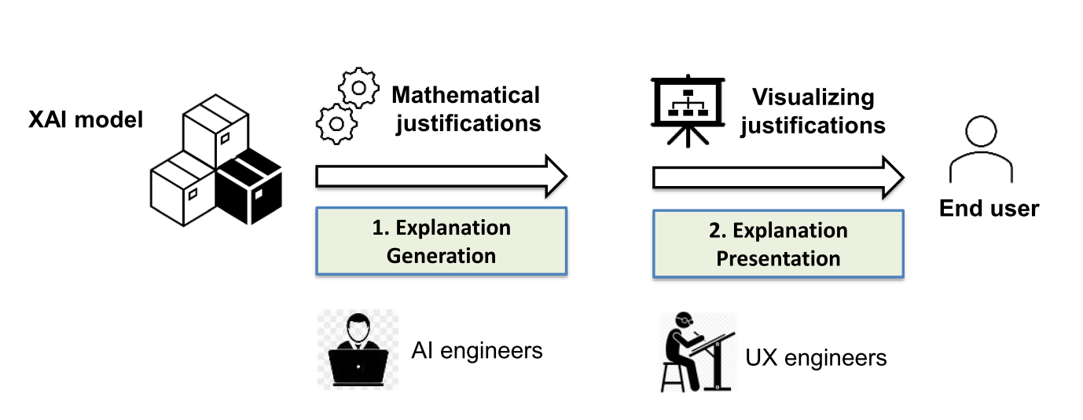
How to surface the explanations?

Slide 45
So…Finally

Slide 46
AI is just a set of algorithms,
which (predominantly ) work given Inputs as well as Outputs
Notes:
What is customer ask?
Who is the user?

Slide 47
For example: to find out clause “Term”…
Need to supply AI algorithm with 100s/1000s of “Term” clause samples
Gets trained on patterns, word frequencies, context words
Stores this information as ‘model’
Can be used to classify unseen clause, whether “Term” or not.
Notes:
What is customer ask?
Who is the user?

Slide 48
Quiz
If you want to find something new say “LIBOR” clause, what would be needed?
Notes:
What is customer ask?
Who is the user?

Slide 49
Let’s Summarize together
AI-ML-DL approaches are not deterministic (but <>?)
For good results, need good annotated data and lots of it
Annotations need to be perfect (“Gold”), else Garbage-In-<??-<??>
Data should cover all possible variations
AI-ML-DL just fits the data, just that, but it does it automatically!!
ML has better explain-ability than DL (why?)
Notes:
What is customer ask?
Who is the user?

Slide 50
Btw, thoughts to ponder on…
‘AI is biased’ because of its training/data
‘Explainable AI’ is to understand how/why it is biased
But then…
Human are biased too…
‘Explainable Humans’… the next topic for talk? Anyone?

Slide 51
Thank You

Slide 52
yogeshkulkarni@yahoo.com

